Slide 1
Name Artist & Title
Game 013
The Weeknd – Heartless
Beyonce – Cuff It
Imagine Dragons – Believe It
Daft Punk – Get Lucky
Kool & The Gang – Jungle Boogie
Natasha Bedingfield – Unwritten
Pink – Just Like A Pill
Mark Anthony – I Need To Know
Kris Kross – Jump
Simple Minds – Alive and Kicking

Slide 2
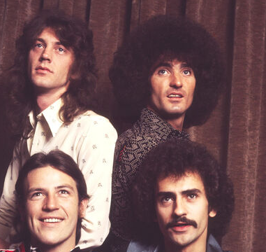
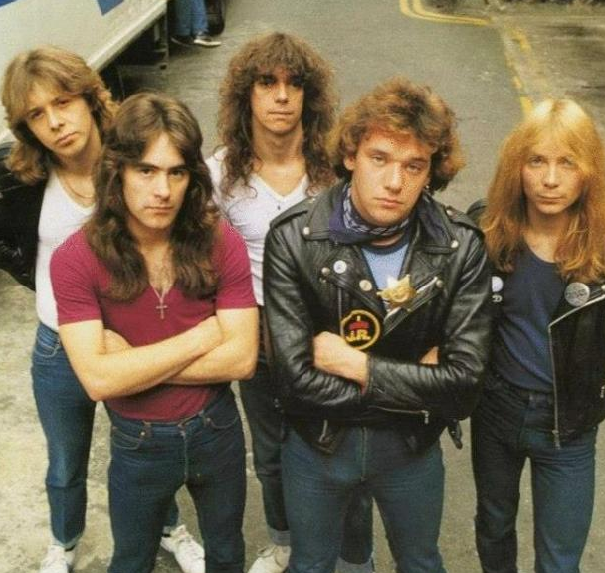
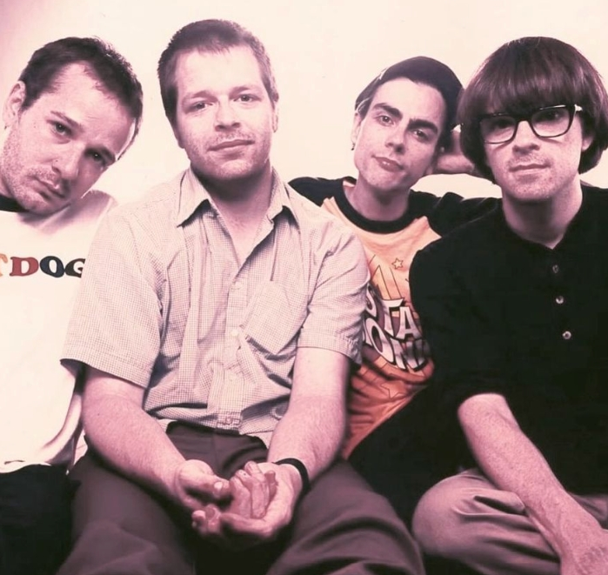
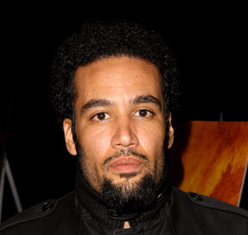
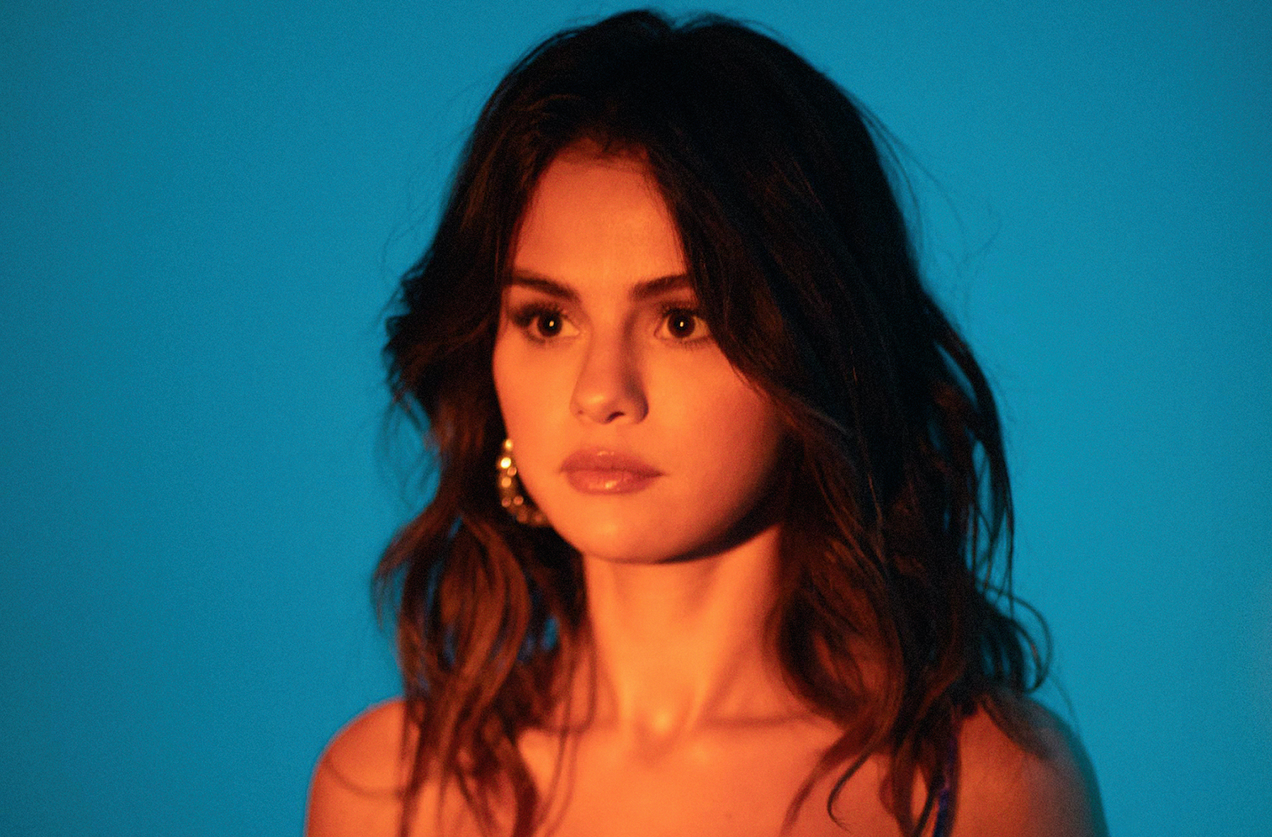
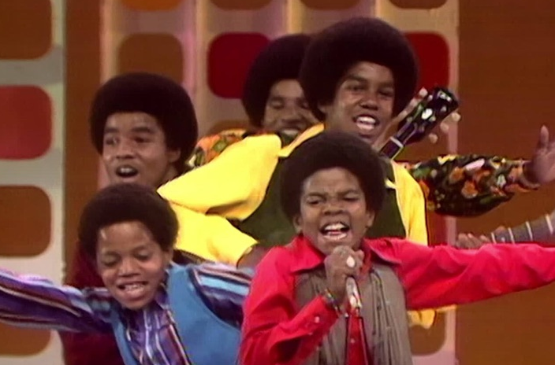
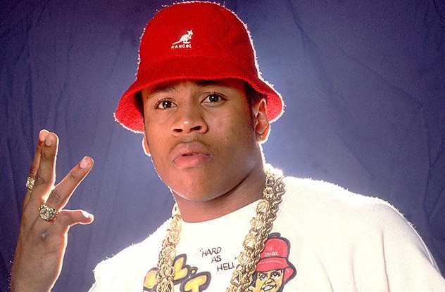
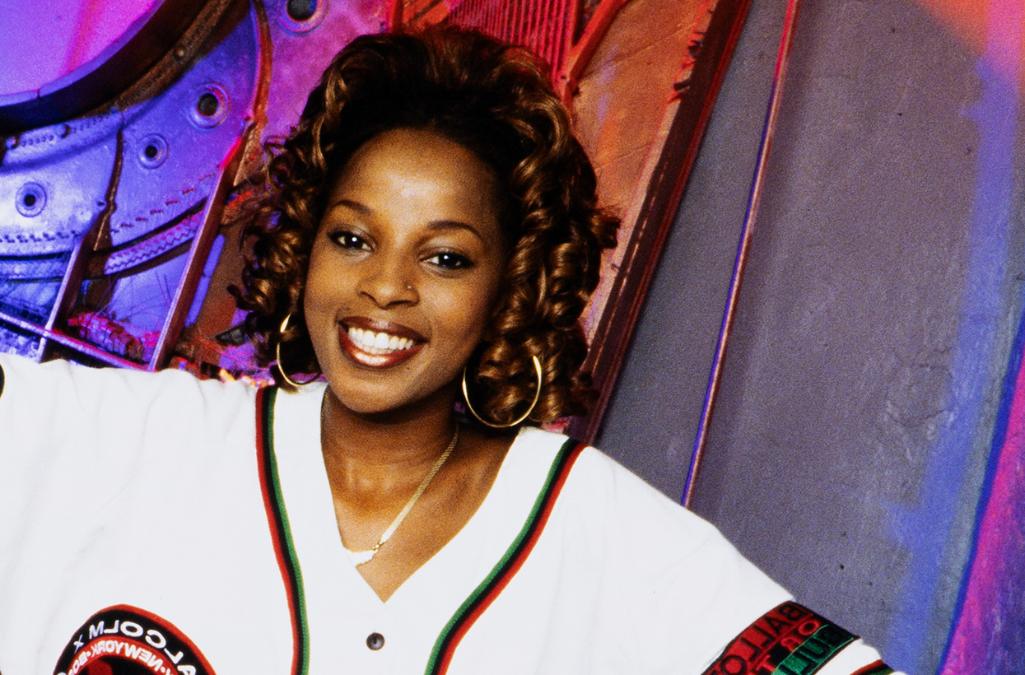
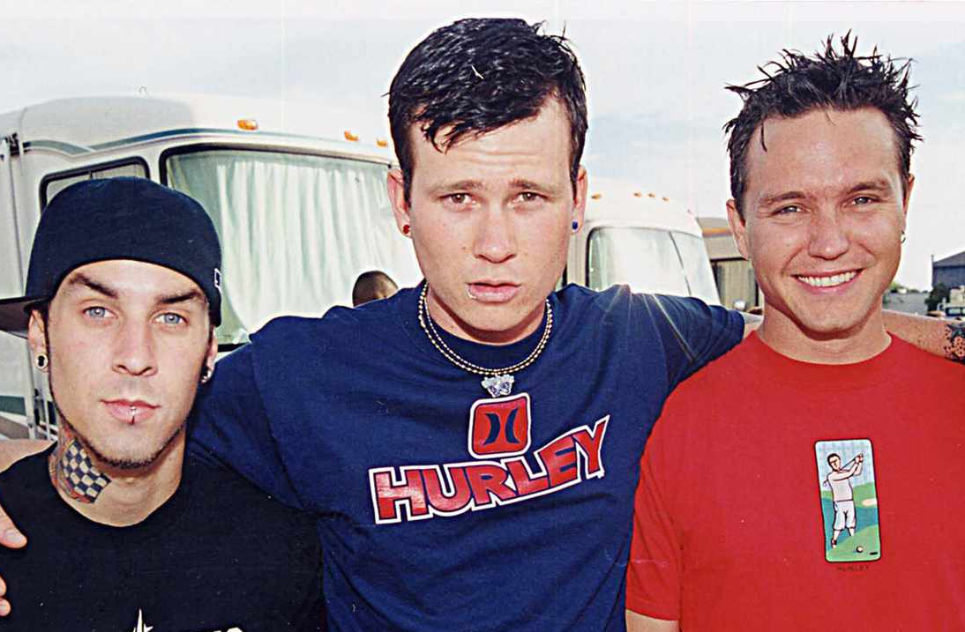
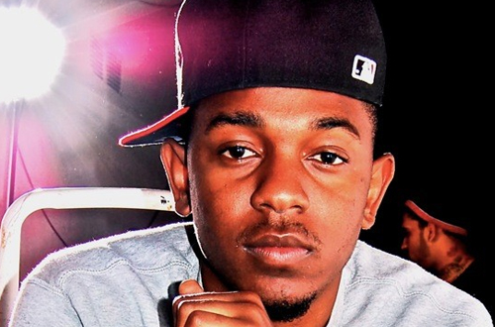
Picture Round
Instructions: Identify the artist or group on the line under each image

Slide 3
Decades In what decade was this version of the song originally released?
David Essex – Rock On – 1974
Kylie Minogue – Can’t Get You Out of My Head – 2001
Blondie – The Tide is High – 1980
Hootie & the Blowfish – Hold My Hand – 1995
Usher & Alicia Keys – My Boo – 2004
Pet Shop Boys – West End Girls – 1986
Nico & Vinz – Am I Wrong – 2014
Ed Sheeran – Shivers – 2022
Marky Mark & the Funky Bunch – Good Vibrations – 1991
Roger Miller – King of the Road - 1965
None

Slide 4
General Knowledge
From 1970-1974 TV’s Friday night lineup included what musical sitcom about a Mom and her 5 kids who form a band and hit the road in a multi-colored school bus? The Partridge Family
Destination Unknown and Walking in L.A. were two hit songs by what 80s new wave band, whose leader singer and drummer (Dale and Terry Bozzio, respectively) were married? Missing Persons
Which boy band’s name was an amalgamation of the last letter of each of the original members’ first names? NSYNC (JustiN, ChriS, JoeY, JasoN, and JC)
Upon whom does Bruno Mars call to “…get the stretch!” in his stratospheric hit Uptown Funk? Julio
What rapper, record producer, and former boyfriend of Ariana Grande’s was posthumously nominated for a Grammy Award for his 2018 album entitled Swimming, shortly after he died at the age of 26? Mac Miller
After the United States Supreme Court overturned Roe v. Wade in 2022, Lizzo donated $500,000 to what non-profit organization that provides reproductive and sexual healthcare and sex education? Planned Parenthood
Sylvester Stallone asked the band Survivor to write the theme song (which turned out to be Eye of the Tiger) for which of his movies, after Queen denied him permission to use their song Another One Bites the Dust? (need the full title) Rocky III
What girl band’s second studio album is called The Writing’s On the Wall? Destiny’s Child
What two artists did Madonna kiss on the lips during her live performance at the 2003 Video Music Awards, setting off a firestorm reaction from the press and the public? Britney Spears and Christina Aguilera
Name the hit song from Luis Fonsi’s 2019 album Vida that music journalists credit with increasing the popularity of Spanish-language pop music in the mainstream market. Despacito
The US (pronounced simply “us”) Festival was the name of two outdoor music festivals held in the early 80s in San Bernardino, CA. What was the total number of attendees at the second festival, which took place in May 1983 over the course of 3 days? 670,000

Slide 6
Grand Funk Railroad
Iron Maiden
Weezer
Ben Harper
Selena Gomez
Jackson 5
LL Cool J
Mary J Blige
Blink-182
Kendrick Lamar

